Slide 1
The City
A brief history of the modern city

Slide 2
Today
Governing the modern city
City and nature

Slide 3
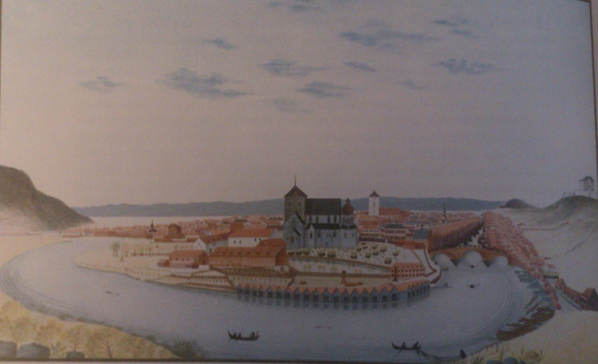
Part I: Governing the modern city

Slide 4
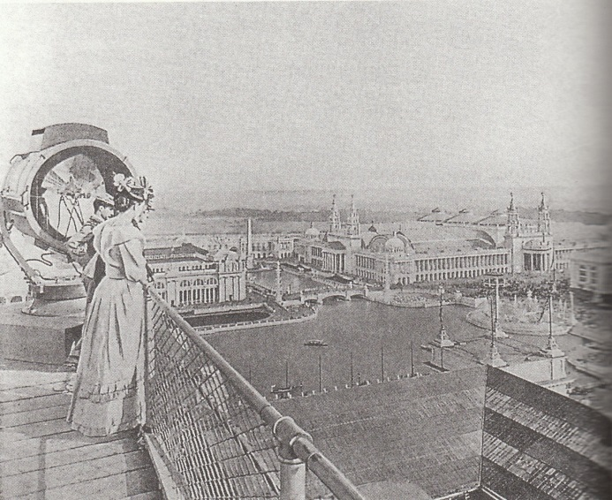
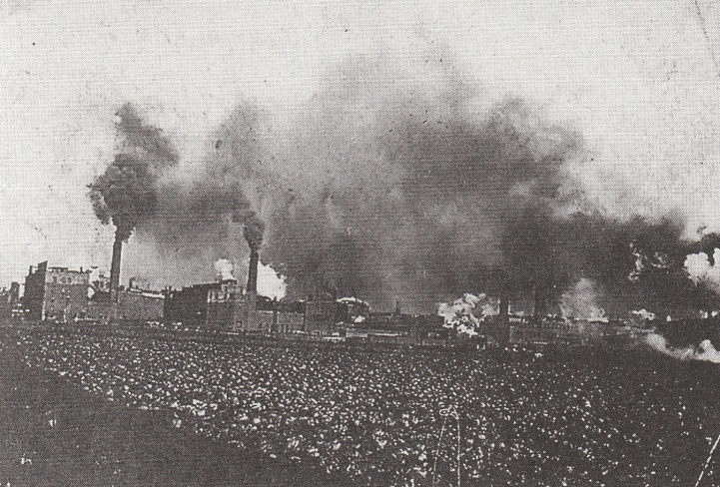
Hygiene as environmentalism
Industrial society required a healthy human stock
Planned environments as solution
Hygiene as sustainability governance – but a restricted one
One of the first environmental policy fields
Very central for the planning and making of the modern city
Antropocentric environmentalism

Slide 5
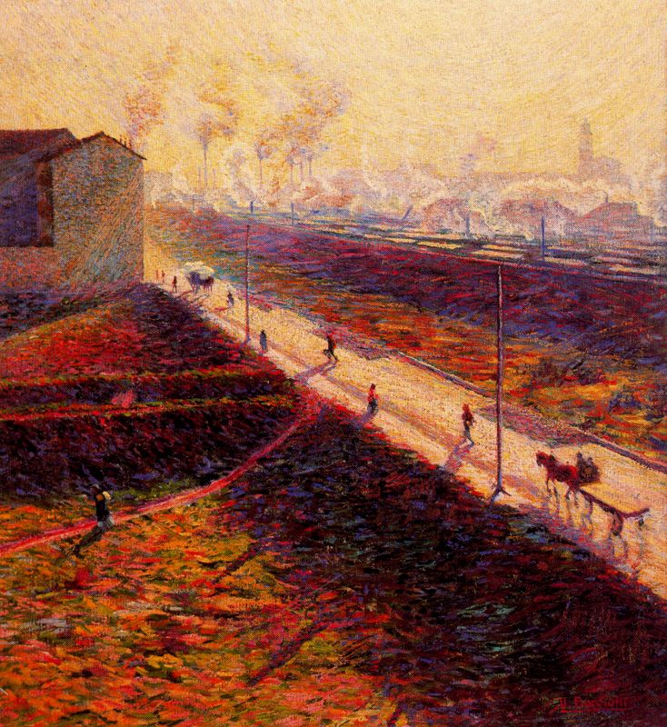
The industrial city
New agricultural technologies
Larger farms
From natural economy to production for sale
Smallholders and farm workers loose their jobs
Forced to travel to the city and its industries
Umberto Boccioni, The morning (1909)

Slide 6
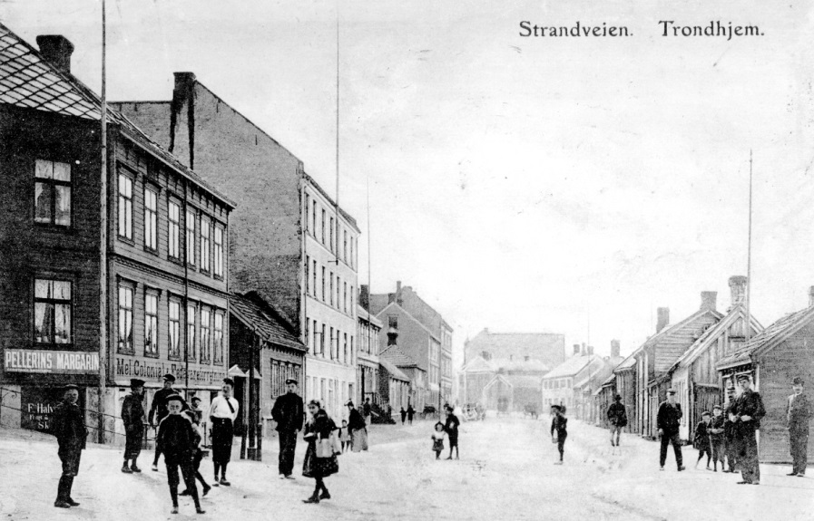
The city as problem, ca. 1900
Poverty
Lack of housing
Clean water and food
Disease
Dirt
The city as producer of disease, a clog in national systems of production

Slide 7

Hygiene
Often used for a synonym for cleanliness
In medicin and public health: health promotion work and preventive medicine
Goal: Improve the health of the population
Ex.: Nutrition, food safety, hospital hygiene, renovation, public health, fitness, aestethics, eugenics, family planning etc.
Very important for urban development in the modern era

Slide 8
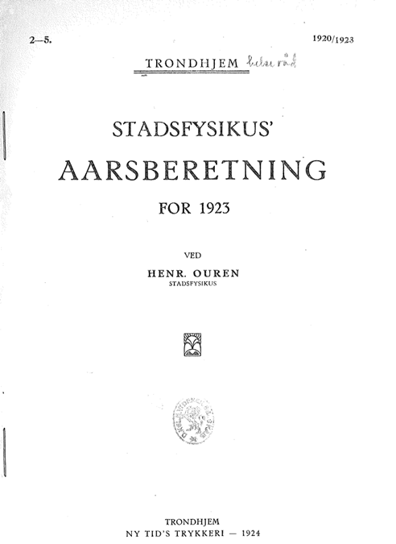
Ex.: Health council in Trondheim
Established in the 1800s
Led by the chief medical officer (stadsfysikus)
Veterinarian, engineer, architect etc. as members
Part of the public health aparatus
Decided on everything from infrastructures to sanatoriums and bath facilities
Almost everything concerning the city had to be approved by the Health Council

Slide 9
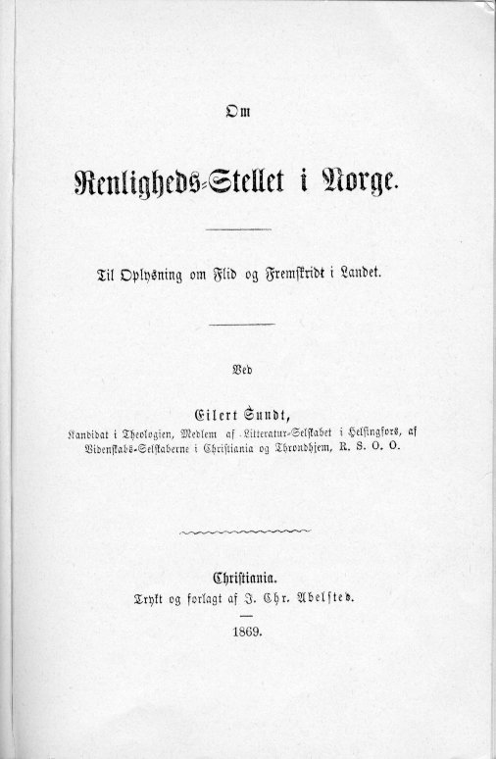
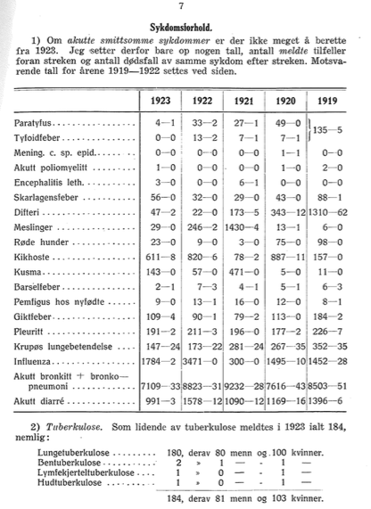
Mapping disease, and a whole lot of other things

Slide 10
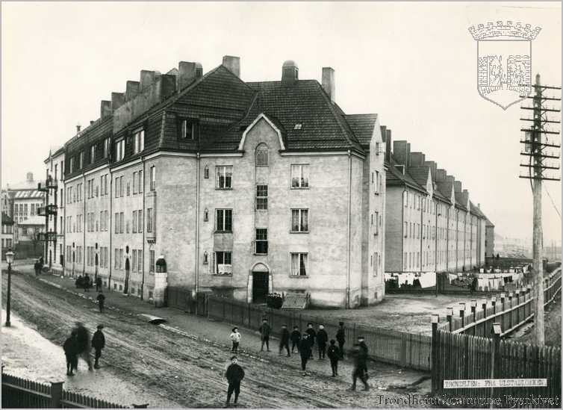
Housing, water and food

Slide 11
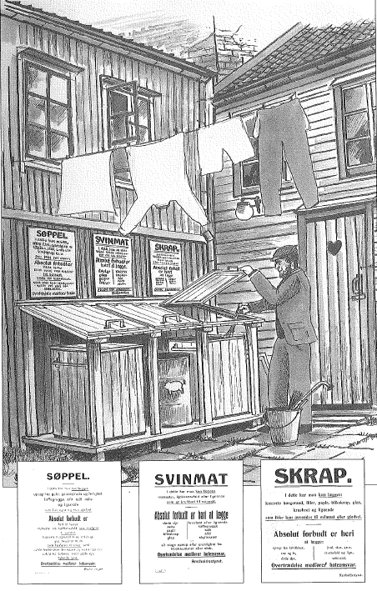
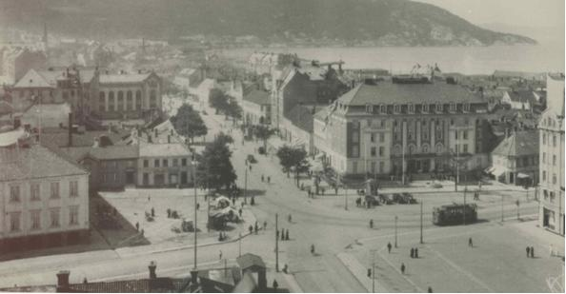
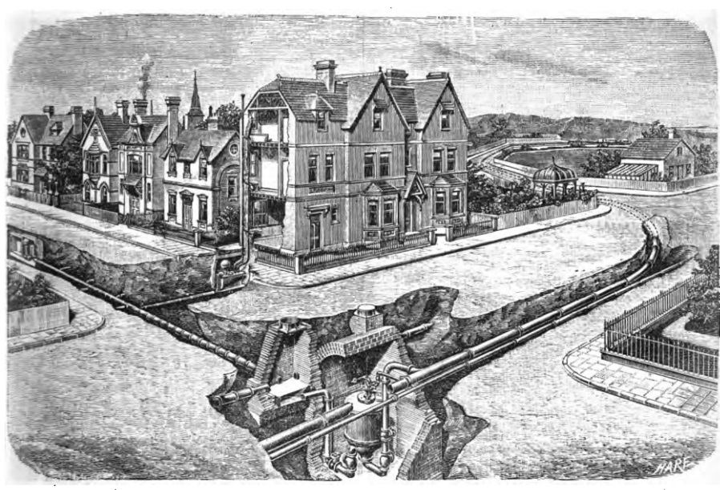
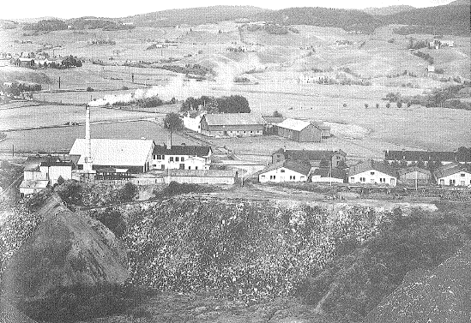
Waste and sewer

Slide 12
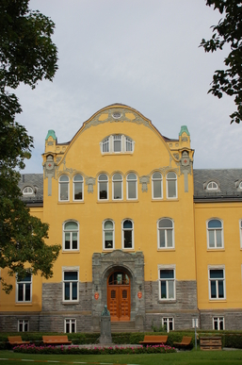
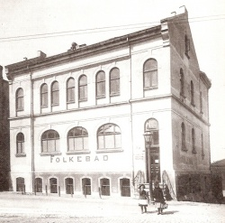
The body

Slide 13
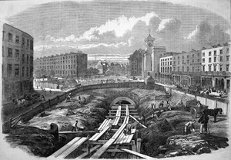
The modern city as hygienic system
The 20th century as the era of systems
The systematization of the city
Hygiene was one of the principles upon which the urban system was built
Le Corbusier: The house is a machine to live in, the chair a machine to sit in, streets produce traffic etc.

Slide 14
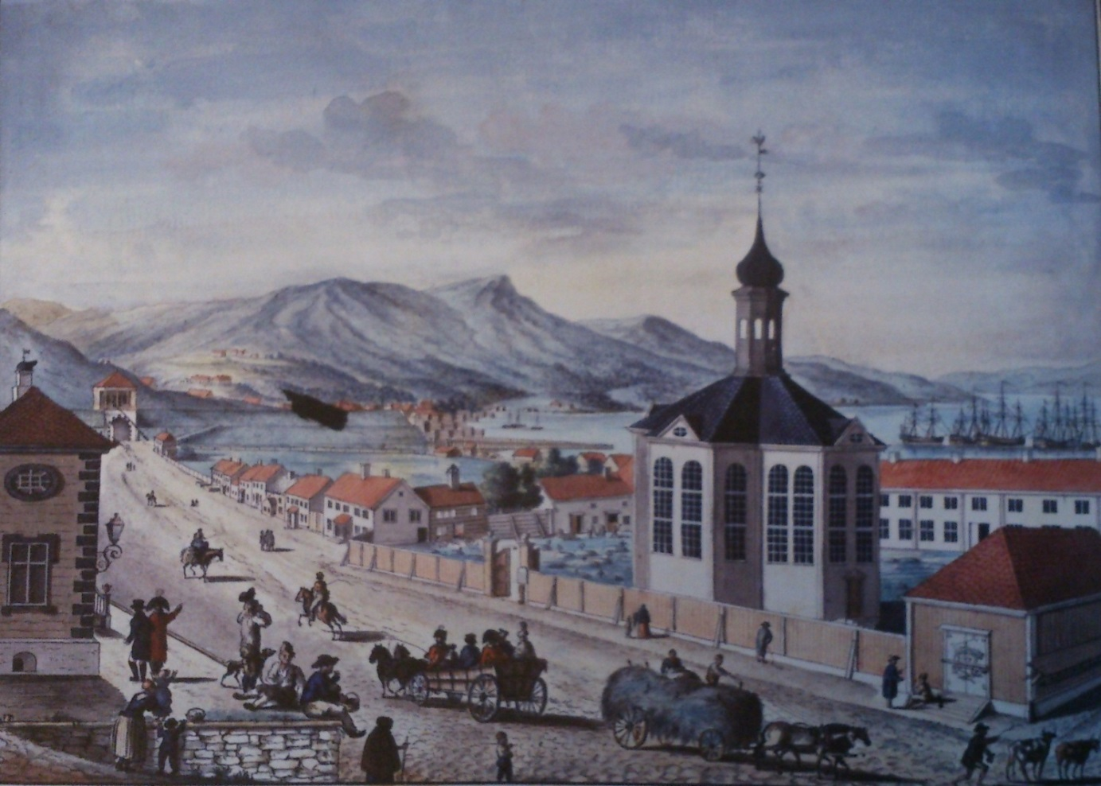
Part II: City and Environment (past and future)

Slide 15
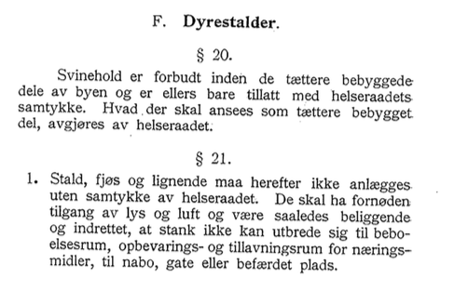
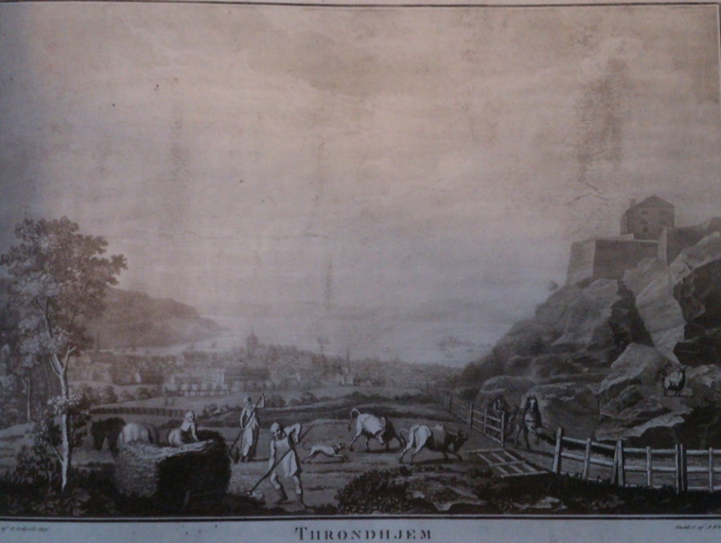
Urban vs agricultural

Slide 16
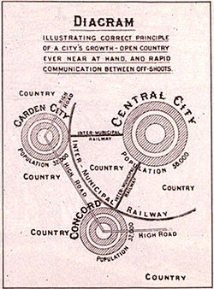
The city and nature/countryside
The city as filthy, the countryside as clean --- changed around 1930 (or even later)
Nature as a space for leisure rather than work (f.ex. tuberculosis)
Hygiene as war on nature (in the city) --- the making of a human space

Slide 17
The urban moment?
The city as demarcated human space
As opposed to nature or the countryside
Did this bounded human space ever really exist?
A dream that seemed true, for some time
Maybe a moment between the 1920s-1980s?

Slide 18
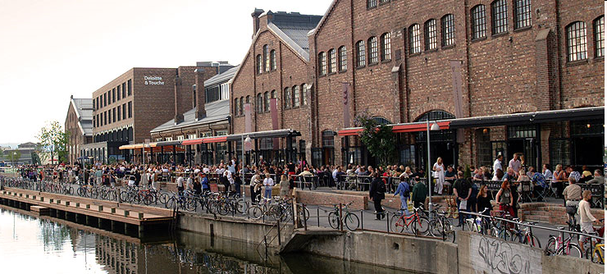
The post-industrial city
A concept invented in the 1950s: from production to service
Out-sourcing – production happen other places
Aker Brygge and Solsiden
De-valuing the need for hygiene?

Slide 19
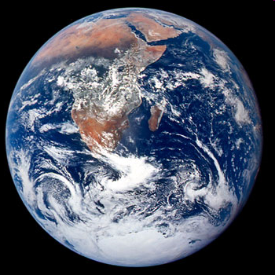
Has the city ever been modern?
Water
Food
Natural resources flowing into the city
But also pollution, waste and emissions
And not restricted space at all
Difficult to see before our era

Slide 20
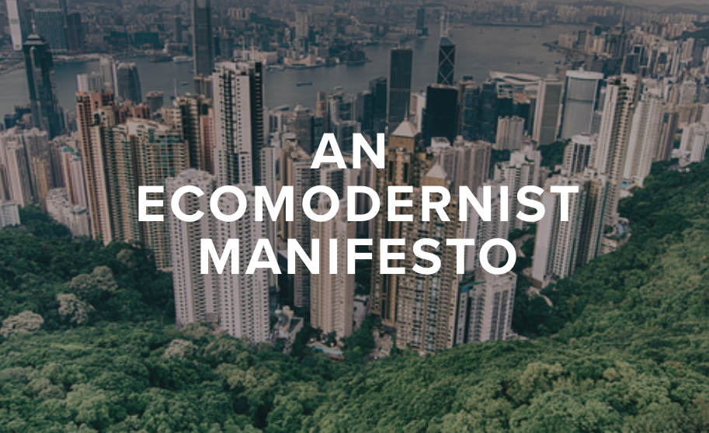
The ecomodernist city
Most people live in cities
Cities as self-supplied systems
Nature left alone to recover
Decoupling city and environment
Sustainability as main planning principle rather than health
From a hygiene protecting humans from «nature» to a hygiene protecting the «planet/nature»

Slide 21
The Anthropocene City?
Ex.: Ecomodernism vs ecological modernization
Reimagining the urban, and its relation to nature
Making space for non-humans, restricting humans?
Or reconnecting city and nature?
How to reimagine?
Without falling into the modernist trap of the blank slate
Or the traditionalist’s dream of going back in time
Playing with the past to create other futures?

